Slide 1
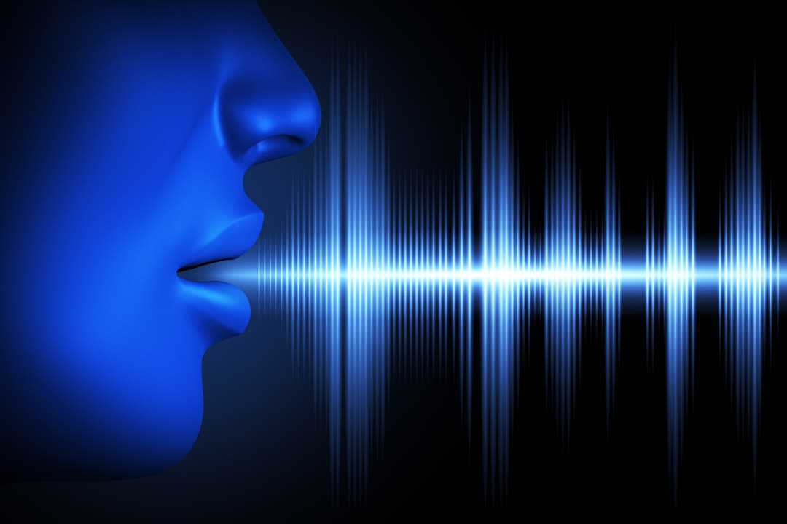
PREDICTION OF PARKINSON DISEASE USING SPEECH SIGNALS
PROJECT GUIDE:
MRS. DEEPA P
TEAM MEMBERS:
MADHUMITHA B D(2018PECCS159)
KEERTHIKA S(2018PECCS152)
HARSHINI C(2018PECCS137)
BATCH: DOMAIN:
A14 DEEP LEARNING

Slide 2
OVERVIEW
Parkinson’s disease (PD) is amongst the relatively prevalent neurodegenerative disorders with its course of progression classified as prodromal, stage1, 2, 3 and sever conditions.
An effective screening process, particularly one that doesn’t require a clinic visit, would be beneficial.
Since PD patients exhibit characteristic vocal features, voice recordings are a useful and non-invasive tool for diagnosis.
If deep learning algorithms could be applied to a voice recording dataset to accurately diagnosis PD, this would be an effective screening step prior to an appointment with a clinician.

Slide 3
LITERATURE SURVEY
TITLE : Parkinson’s Disease Detection Based on Running Speech Data From Phone Calls
YEAR : 2021
JOURNAL NAME : International Journal of Biomedical Engineering.
AUTHOR : Christos Laganas, Dimitrios Iakovakis, Stelios Hadjidimitriou, Vasileios Charisis METDHODOLOGY :
A machine learning-based approach for voice based smartphone data from subjects’ running speech recordings .
ADVANTAGE:
Detection of PD is done by language-dependent training
DISADVANTAGE:
Language dependent Training is a tedious process.

Slide 4
LITERATURE SURVEY
TITLE : Multi-modal brain based prediction of Parkinson disease using Graph Attention Networks
YEAR : 2022
JOURNAL NAME : Frontiers in Neuroscience.
AUTHOR : Apoorva Safai, Nirvi Vakharia, Shweta Prasad, Jitender Saini, Apurva Shah, Abhishek Lenka, Pramod Kumar Pal, and Madhura
METHODOLOGY :
GAT(GRAPH ATTENTION NETWORK) model is used to generate node embeddings from the structural connectivity matrix and multimodal feature.
ADVANTAGE : The attention map shows the dependency between large scale brain regions based on their structural and functional characteristics.
DISADVANTAGE: GAT at-times provide inconsistent data which is not accurate.

Slide 5
LITERATURE SURVEY
TITLE : Vocal Feature Extraction based Artificial Intelligence model for Parkinson disease detection
YEAR : 2021
JOURNAL NAME : Pubmed Journal
AUTHOR : Muntasir Hoq, Mohammed Nasim Uttin , And Seung-vo Park
METHODOLOGY :
Two hybrid models based on SVM integrating with principle component analysis and a sparse auto-encoder are proposed to detect PD patients based on vocal features.
ADVANTAGE: It is used to evaluate the model performance to find out the best one.
DISADVANTAGE:
In this paper, 70% of data were are used for training and 30% of data were used for testing and Real-time data is not tested.

Slide 6
LITERATURE SURVEY
TITLE : An Early Prediction of Parkinson’s disease using facial emotional Recognition.
YEAR : 2021
JOURNAL NAME : International Conference on Novel Approaches and Developments in Biomedical Engineering
AUTHOR : Anusri , Dhatchayani , Princely Angelinal , Dr . S. Kamalraj
METHODOLOGY:
It is implemented using by classifying facial emotions using CNN architecture.
ADVANTAGE :
Outcome of PD from DAT SPECT images in which they obtained 70.7% accuracy in CNN
DISADVANTAGE:
Due to insufficient dataset , the result will not be accurate.

Slide 7
LITERATURE SURVEY
TITLE : Early Parkinson detection using fully connected deep neural network based on vocal features.
YEAR : 2020
JOURNAL NAME : International Journal of Computer Science And Technology.
AUTHOR : Ahlem Kehili , Dabbadi Karim , Cherif Adnen.
METDHODOLOGY :
PD detection system based on vocal features was proposed using fully connected deep neural network as a classifier.
ADVANTAGE:
Accuracy is 100% only when using the dataset
DISADVANTAGE:
It is not implemented in real-time

Slide 8
LITERATURE SURVEY
TITLE : Parkinson’s Disease Diagnosis and Severity Assessment Using Ground Reaction Forces and Neural Networks
YEAR : 2020
JOURNAL NAME : Frontiers in Physiology.
AUTHOR : Srivardhini Veeraragavan, Alpha Agape Gopalai
METHODOLOGY :
Gait features are extracted and selected to use as training features for the Artificial Neural Network (ANN) model to diagnose PD using cross validation.
ADVANTAGE:
PD Diagnosis is achieved with a high accuracy of 97.4% using simple network architecture
DISADVANTAGE:
GRF ‘s acceleration forces cannot be accurate since it depends on body movements.

Slide 9
LITERATURE SURVEY
TITLE :A Comparative Analysis Of Parkinson Disease Prediction Using Machine Learning Approaches.
YEAR : 2019
JOURNAL NAME : International Journal of Scientific and technology research.
AUTHOR : F.M. Javed Mehedi Shamrat, Md. Asaduzzaman.
METHODOLOGY :AI methods for the detection of Parkinson disease datasets using SVM, KNN, and LR.
ADVANATAGE:
The application will be able to detect in Parkinson disease in very few minutes and notify the dangerous probability of having the disease.
DISADVANTAGE:
Performance is low and needs to be improvised.

Slide 10
LITERATURE SURVEY
TITLE : Prediction of Parkinson’s disease using Ensemble Machine Learning classification from acoustic analysis.
YEAR : 2019
JOURNAL NAME : International Journal of Biomedical Engineering.
AUTHOR : Amit Kumar Patra , Ratula Ray , Azian Azamimi Abdullah
METHODOLOGY :
It is implemented using Decision Trees, Logistic Regression and K-nearest neighbors .
ADVANTAGE : Average vocal fundamental frequency have showing higher ranking, more correlation to the prediction outcome of the classification.
DISADVANTAGE:
Though the f1-scoring system as the standard metrics for classification, Boosting shows only slight better result (83%)

Slide 11
LITERATURE SURVEY
TITLE : Imaging Approaches to Parkinson Disease
YEAR : 2018
AUTHOR : David J. Brooks
JOURNAL NAME : Journal of Nuclear Medicine
METHODOLOGY :
Structural changes in PD nigra can be detected with both transcranial sonography and diffusion tensor MRI.
ADVANTAGE:
Transcranial sonography reveals a susceptibility to PD .
DISADVANTAGE:
Sonography involves repetitive motions that result in a higher rate of pain for the patients.

Slide 12
LITERATURE SURVEY
TITLE : Predicting severity of Parkinson disease using deep learning
YEAR : 2018
AUTHOR : Srishti Grover, Saloni Bhartia, Akshama, Avilasha Yadav
JOURNAL NAME : International Conference on Computational Intelligence and Data.
METHODOLOGY :
The collected data is normalized using min-max normalization. The deep neural network is designed with input layer, hidden layers and output layer.
ADVANTAGE:
Accuracy is more when small dataset is used.
DISADVANTAGE:
It is not suitable for large dataset.

Slide 13
PROBLEM DEFINITION
Prompt diagnosis of PD is important in order to provide patients with appropriate treatment and information on prognosis.
However, an accurate early diagnosis can be challenging because the movement symptoms can overlap with other conditions.
Doctors make the diagnosis of PD based on clinical evaluation, interpreting information gained predominantly through history-taking and examination of the patient.
In this paper, we describe the training and selection of the deep learning model. Unlike earlier work in this area.
we focus on developing a model that can diagnose Parkinson’s disease from voice.
Also of importance from a clinical perspective, we show that PD can be diagnosed using an intentionally simple CNN model.
Simple models are more likely to generalize beyond their training data and hence are considered more trustworthy for medical diagnosis.

Slide 14
FEASIBILITY STUDY
ECONOMICAL
TECHNICAL
SOCIAL

Slide 15
ECONOMICAL FEASIBILITY
This website is economically feasible since any device like laptop or mobile phone have microphone access through which the voice is given.
Open source python framework called flask is used in the user interface.
Parkinson Disease is a brain neurological disorder. It leads to shaking of the body, hands and provides stiffness to the body. No proper cure or treatment is available yet at the advanced stage. By detecting in advance its reduce the cost of treatment.

Slide 16
TECHNICAL FEASIBILITY
Python:
Python is used here for predictive modeling because Python-based frameworks give us results faster and also help in the planning of the next steps based on the results.
Flask framework:
Flask is a web application framework written in python, in simple terms it helps end users interact with our python code directly from their web browser without needing any libraries , code files, etc.
CNN:
The purpose of using convolutional neural network in our project is because it performs prediction on identification efficiently.
Immense datasets are applied to CNNs, it is even considered that larger the data, greater the accuracy will result.

Slide 17
SOCIAL FEASIBILITY
This website will be helpful for the whole society. Since the Parkinson disease affects mostly the elder people ,it can be predicted from their place of stay without visiting hospitals in-person.
The elderly people cannot make movements, particularly people affected by Parkinson will have tremor, hand shake etc. At that time, voice can be recorded and tested which we will be very helpful for all the people in the world.
This will have a great impact in the society.
Therefore, predicting this disease is very important in its earlier stage itself so that an early plan can be made by the people to take necessary treatments or actions against this dangerous disease. The minor symptoms of this disease are well known to the general public. However, the later stage symptoms are very hard to predict or detect by people around the world. Yet there is an increased number of researches being done to predict Parkinson’s disease, the non-motor symptoms preceding the motor one still remains as a myth. If a reliable and early stage can be predicted, a patient should be able to receive correct treatment in a right period.

Slide 18
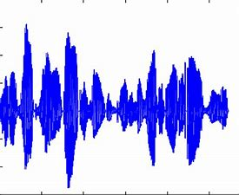
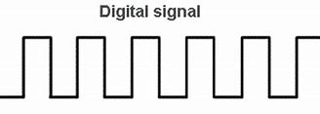


SYSTEM ARCHITECTURE
Audio signal
Pre-processing
Feature extraction
Pre-processing
Feature extraction
Deep learning algorithm
Audio signal
Parkinson
Healthy

Slide 19
REFERENCES
Christos Laganas, Dimitrios Iakovakis, Stelios Hadjidimitriou, Vasileios Charisis, Sofia B. Dias, Sevasti Bostantzopoulou, Zoe Katsarou, Lisa Klingelhoefer, Heinz Reichmann, Dhaval Trivedi, K. Ray Chaudhuri, and Leontios J.Hadjileontiadis, Senior Member, IEEE(2021) “Parkinson’s Disease Detection Based on Running Speech Data From Phone Calls”, IEEE Transactions on Biomedical Engineering : DOI 10.1109/TBME.2021.3116935,
https://ieeexplore.ieee.org/stamp/stamp.jsp?arnumber=9556632
Ahlem Kehili, dabbabi Karim, Cherif Adnen (2020) “Early Parkinson Detection Using Fully-Connected Deep Neural Network based on Vocal Features “ ,IJCSNS International Journal of Computer science and Network Security , University of Tunis , VOL.20 N0.6 June 2020
https://www.researchgate.net/publication/343100129_Early_Parkinson_Detection_Using_Fully-Connected_Deep_Neural_Network_based_on_Vocal_Features
J. Sujatha, Dr . S.P. Rajagopalan(2017), “Performance Evaluation of Machine Learning Algorithms in the Classification of Parkinson Disease Using Voice Attributes “, International Journal of Applied Engineering Research , India : ISSN 0973-4562 Volume 12, Number 21
http://www.ripublication.com/ijaer17/ijaerv12n21_24.pdf
Srishti Grover, Saloni Bhartia, Akshama, Abhilasha Yadav, Seeja K.R(2018), “Predicting Severity Of Parkinson’s Disease Using Deep Learning”,International conference on Computational Intelligence and Data ,Department of Computer Science and Engineering Indira Gandhi Delhi Technical University for Women, Kashmere Gate, Delhi, 110006, India, Procedia Computer Science Volume 132 , Pages 1788-1794,2018
https://www.sciencedirect.com/science/article/pii/S1877050918308883

Slide 20
REFERENCES
Shubham Bind , Arvind Kumar Tiwari , Anil Kumar Sahani(2015),” A Survey of Machine Learning Based Approaches for Parkinson Disease Prediction” (IJCSIT) International Journal of Computer Science and Information Technologies, Department of CSE, KIT, Department of CSE, IIT (BHU) Varanasi, India , Vol. 6 (2) , 2015, 1648-1655
https://citeseerx.ist.psu.edu/viewdoc/download?doi=10.1.1.735.5660&rep=rep1&type=pdf
Amit Kumar Patra , Ratula Ray, Azian Azamimi Abdullah, Satya Ranjan Dash(2019),” Prediction of Parkinson's disease using Ensemble Machine Learning classification from acoustic analysis “, Journal of Physics: Conference Series, IOP publications , UK, Volume : 1372, NO:1742-6596/1372/1/012041
https://iopscience.iop.org/article/10.1088/1742-6596/1372/1/012041/pdf
Apoorva Safai, Nirvi Vakharia, Shweta Prasad, Jitender Saini, Apurva Shah, Abhishek Lenka, Pramod Kumar Pal, and Madhura,” Multi-modal brain based prediction of Parkinson disease using Graph Attention Networks”, Researchgate, Volume : 15 , article :748414
https://www.researchgate.net/publication/358798991_Multimodal_Brain_Connectomics-Based_Prediction_of_Parkinson's_Disease_Using_Graph_Attention_Networks
F.M. Javed Mehedi Shamrat, Md. Asaduzzaman(2019),” A Comparative Analysis Of Parkinson Disease Prediction Using Machine Learning Approaches”, International Journal of Scientific and technology research, VOLUME 8, ISSUE 11, PN.NO – 2576-2580
https://www.researchgate.net/publication/338924577_A_Comparative_Analysis_Of_Parkinson_Disease_Prediction_Using_Machine_Learning_Approaches

Slide 21
THANK YOU

